Slide 1
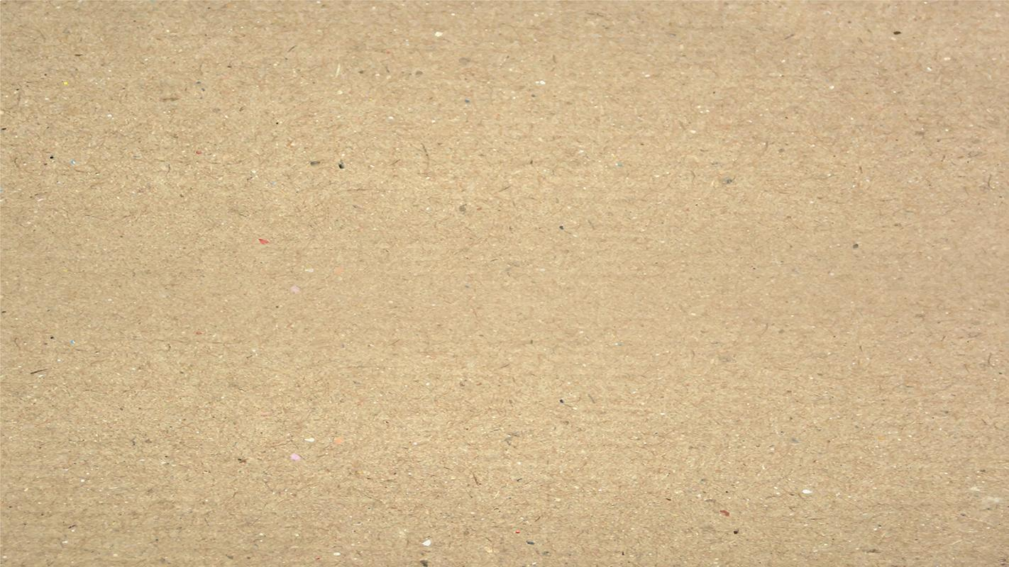
Air Canvas
A049 – Bhavin Savaliya
A073 – Bhavesh Mandavkar

Slide 2
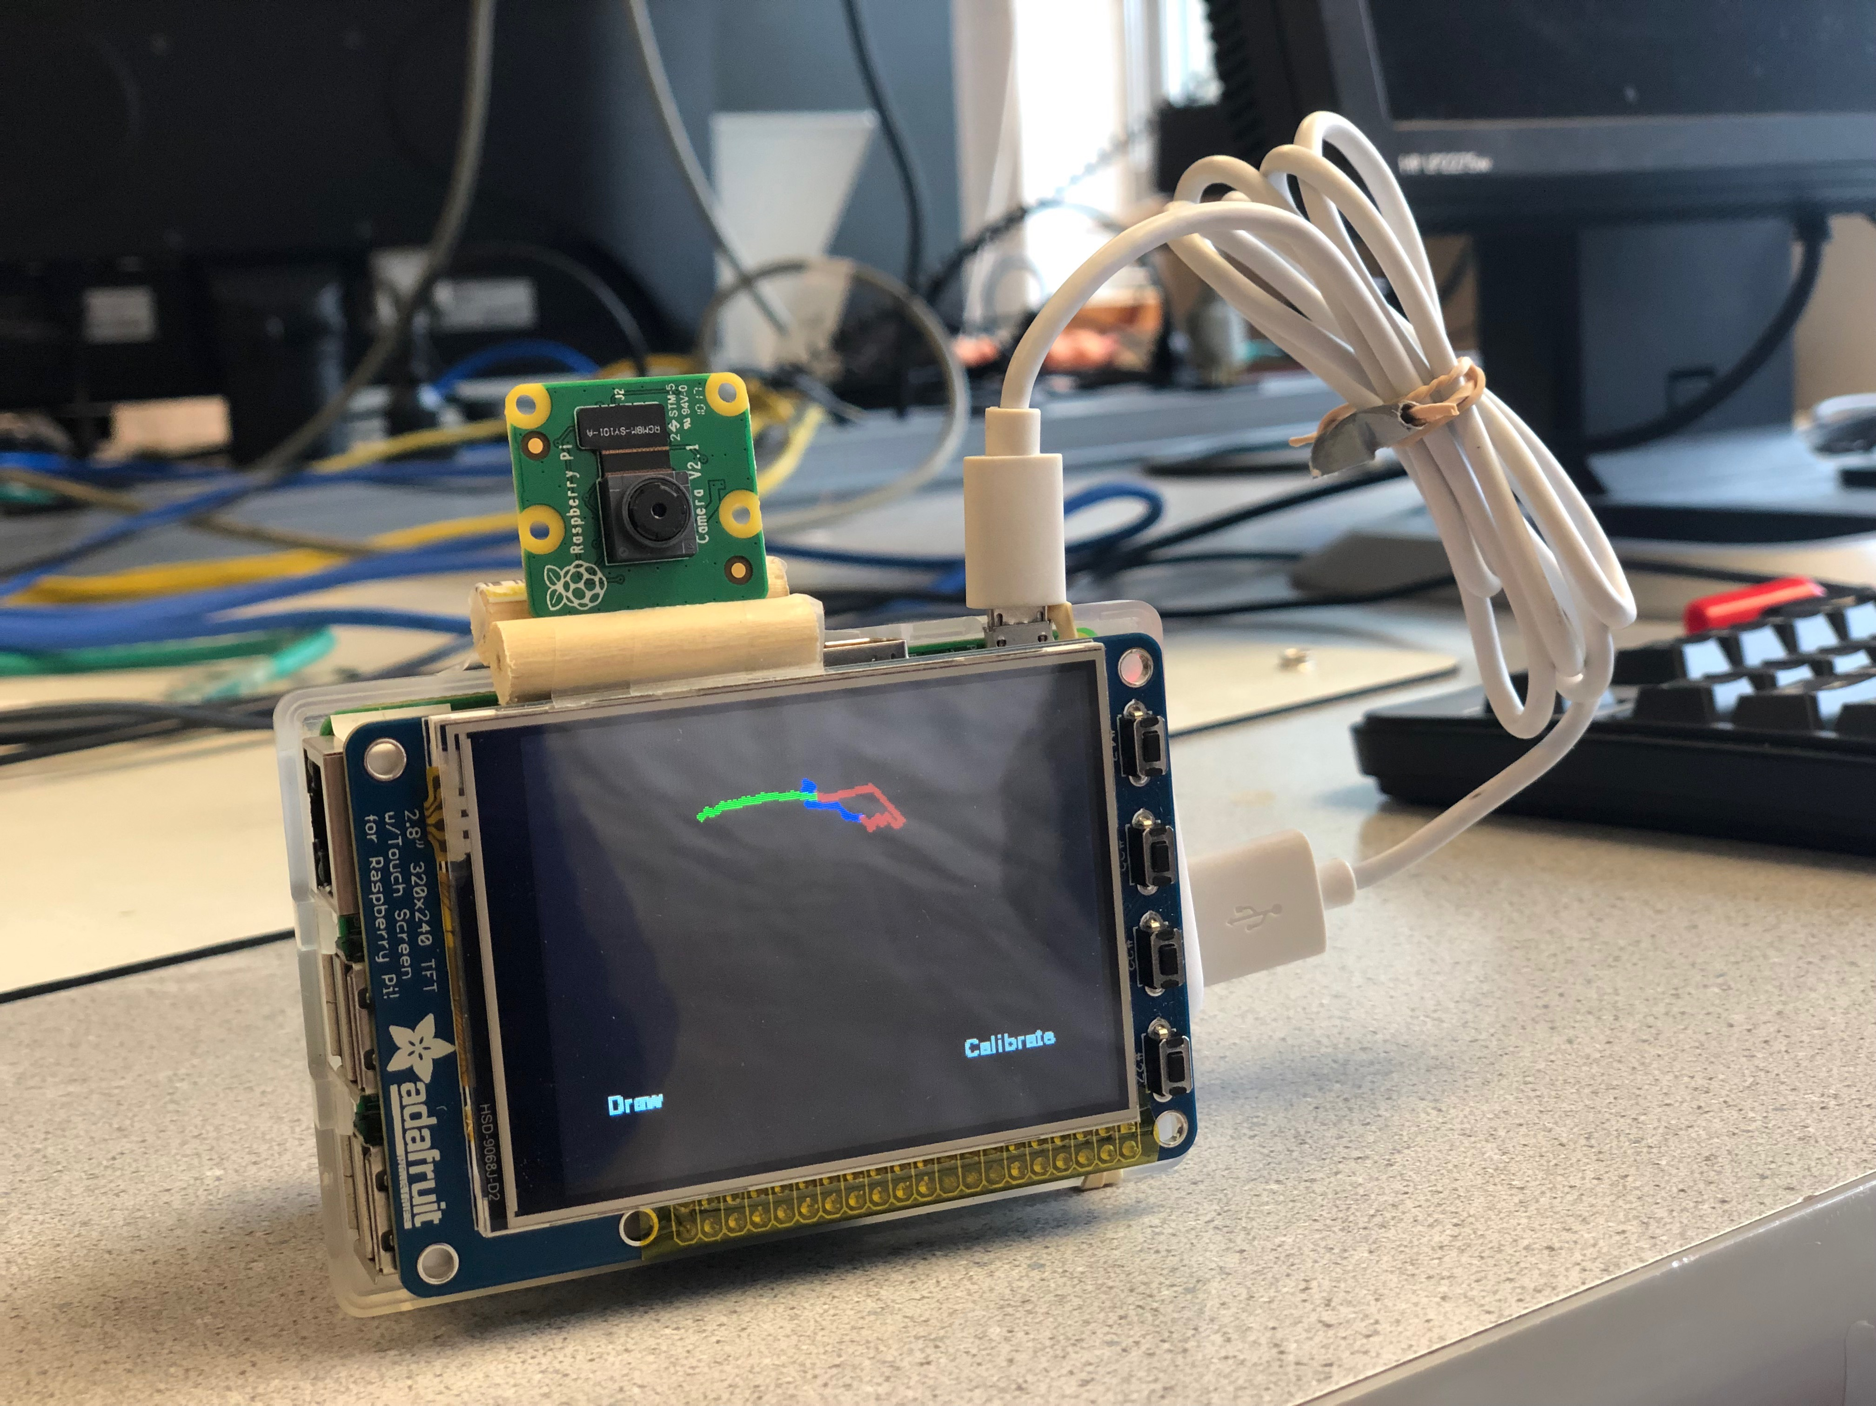
Introduction
Hands-free Digital Drawing Canvas
Camera, Computer Screen And OpenCV
Can Be Modified In Size And Color
A Calibration Screen

Slide 3
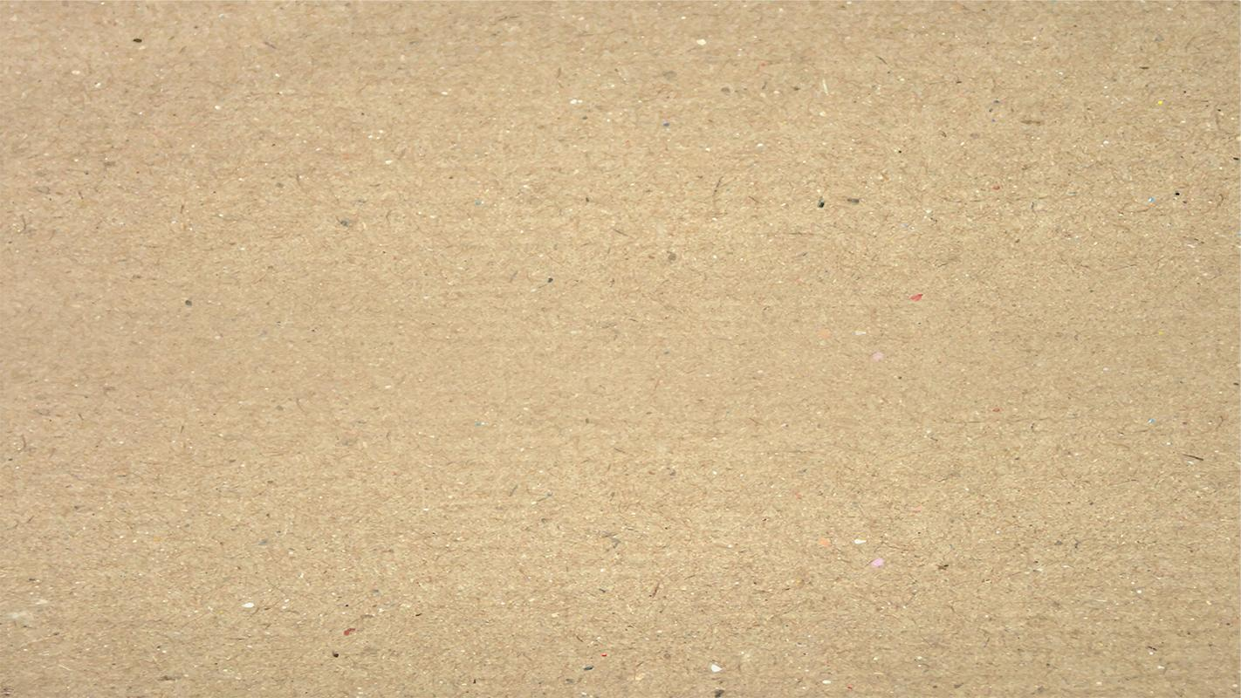
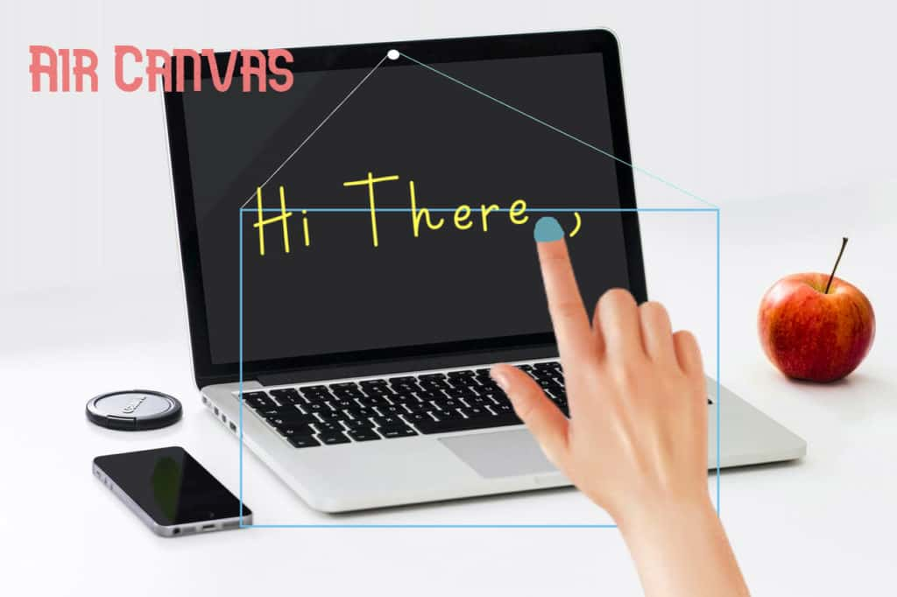
Design Overview
The Basic Goal Of Air Canvas Is To Map The Coordinates Of The User’s Pointer Finger To The Screen, Where Colored Circles Are Drawn And Connected To Simulate A Crude Brush Stroke.
Our Project Consisted Of Following Hardware Devices:
Display Screen
Camera.

Slide 4
Algorithm
Start reading the frames and convert the captured frames to color space .
Prepare the canvas frame and put the respective ink buttons on it.
Adjust the track bar values for finding the mask of the colored marker.
Preprocess the mask with morphological operations.
Detect the contours for drawing points on canvas.
Finally draw the points stored in an array on the frames and canvas.

Slide 5
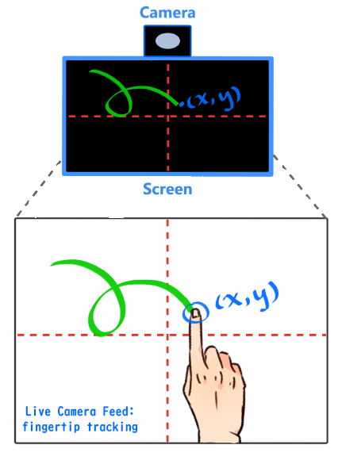
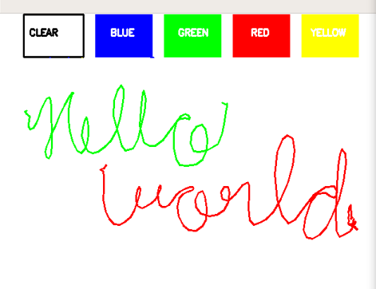

Slide 6
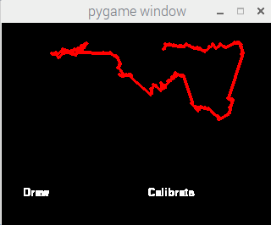
OpenCV
Hand Gesture Recognition Software
OpenCV In Combination With Python
Image Processing Algorithms
Image Masking
Adapt To Changing Light Conditions
Finger Tracking Algorithm

Slide 7
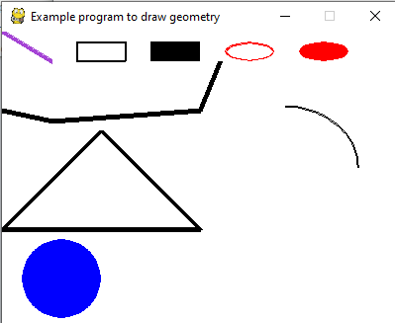
PyGame Drawing
Cross-platform
Computer Graphics And Sound Libraries
Client-side, Standalone Applications
Geometric Functions

Slide 8
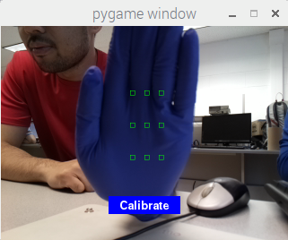
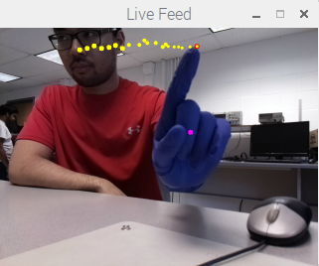

Slide 9

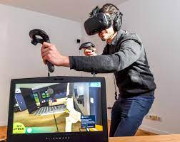
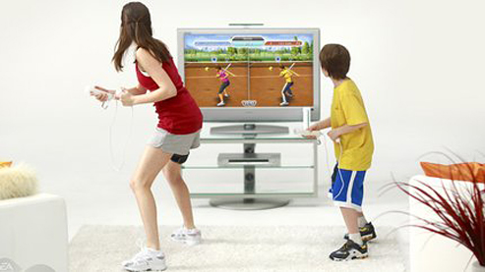
Current Scenario
Gaming
Business
Education
Medical Field
Virtual reality – VR

Slide 10
Future Work
To Enhance Hand Gesture Tracking
Line Drawing Method
More Robust As A Drawing Program
Could Be Connected To Different Digital Drawing Program
Resemble Real Creativity Software

Slide 11
Conclusion
With Air Canvas, we have achieved a hands-free drawing program that uses OpenCV to detect the user’s pointer finger. Colorful lines can be drawn wherever the user desires and the brush can even be modified. It is truly like drawing in the air!

Slide 12
References
Finger Detection:
https://github.com/lzane/Fingers-Detection-using-OpenCV-and-Python
OpenCV contours:
https://docs.opencv.org/3.4.2/d4/d73/tutorial_py_contours_begin.html
Drawing in PyGame:
https://www.pygame.org/docs/ref/draw.html
Guide to Set Up Camera & Some OpenCV Image Processing

Slide 13
Thank You ☺

